Slide 1
Lecture #9
SOFT COMPUTING
INT508

Slide 2
Kohonen neural network or
Kohonen’s self organizing map or
Self Organizing Map or
Self Organizing Feature Map

Slide 3
unsupervised learning
competitive learning
winner-takes-all principle
normally represented as a bi-dimensional map

Slide 4
Unlike other learning technique in neural networks, training a SOM requires no target vector. A SOM learns to classify the training data without any external supervision.

Slide 5
The most common metric is the Euclidean
Self Organizing Map(SOM) by Teuvo Kohonen provides a data visualization technique which helps to understand high dimensional data by reducing the dimensions of data to a map.
SOM also represents clustering concept by grouping similar data together.

Slide 6
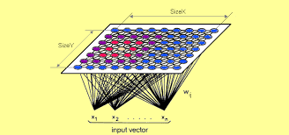

Slide 7
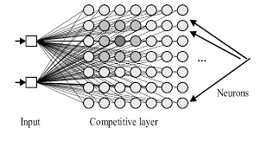

Slide 8
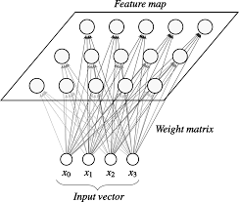

Slide 9
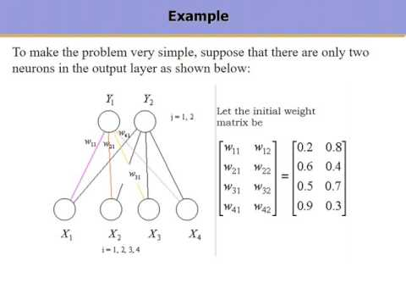

Slide 10
Self-Organizing Neural Network Learning Algorithm:
Step 0:
Initialize synaptic weights to random values in a specific interval like, [-1, 1] or [0, 1].
Assign topological neighborhood parameters.
Define learning rate (say, 0.1).
Step 1: Until termination condition is reached, do loop: Steps 2-8
Step 2: For randomly chosen input vector from the set of training samples, do loop: Steps 3-5.

Slide 11
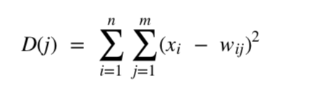
Self-Organizing Neural Network Learning Algorithm:
Step 3: Synaptic weight vector of the winning neuron for the input vector . For each , Euclidean Distance is calculated between a pair of (n X 1) vectors and is represented by-
This is a criteria to finding similarity between two sets of samples. The nodes (neurons) in the network are evaluated to determine the most likely input vector according to its weights

Slide 12
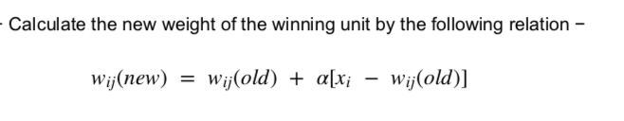
Self-Organizing Neural Network Learning Algorithm:
Step 4: To select the winning neuron, , that best matches the input vector , so that the D(j) is minimum.
Step 5: Now it is the Learning phase; to update the synaptic weights. For all nodes within the neighborhood of that neuron, for every :

Slide 13
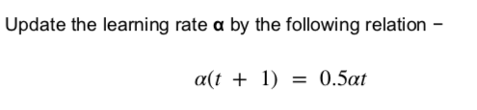
Self-Organizing Neural Network Learning Algorithm:
Step 6: Update the learning rate . Following the equation-
Step 7: At specified times reduce radius of topological neighborhood BMU. As per the clustering process progresses, the radius of the neighborhood around a cluster unit also decreases accordingly.
Step 8: Check for the termination condition.

Slide 14
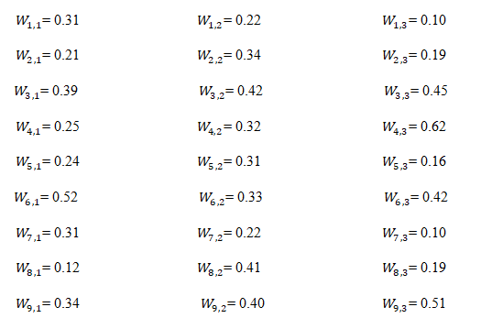
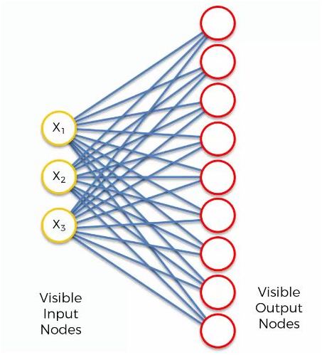
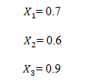

Slide 15
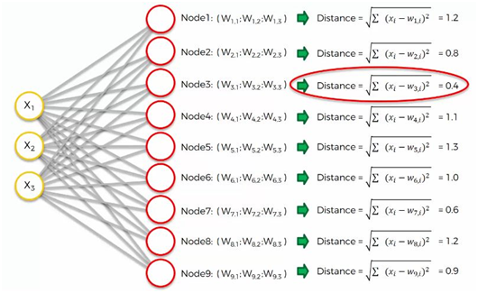

Slide 16

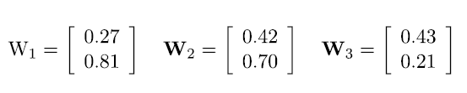
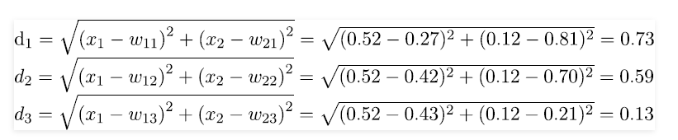
Example with iterations:
Take an input vector of 2 – Dimension:
The initial weight vectors, , are given by

Slide 17
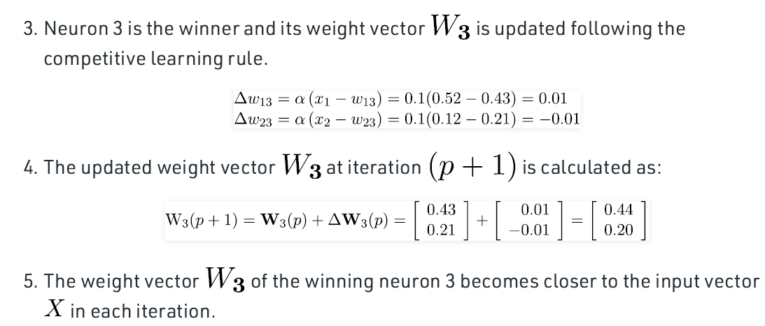

Slide 18
Learning vector quantization
Vector Quantisation is a technique that exploits the underlying structure of input vectors for the purpose of data compression.
An input space is divided in a number of distinct regions and for each region a reconstruction (representative) is defined.
When the quantizer is presented with a new input vector, the region in which the vector lies is first determined, and is then represented by the reproduction vector for this region.
The collection of all possible reproduction vectors is called the code book of the quantizer and its members are called code words.

Slide 19
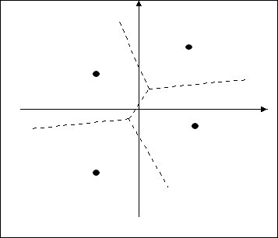
Learning vector quantization
A vector quantizer with minimum encoding distortion is called Voronoi or nearest-neighbour quantizer, since the Voronoi cells about a set of points in an input space correspond to a partition of that space according to the nearest-neighbour rule based on the Euclidean metric.
An example with an input space divided to four cells and their associated Voronoi vectors is shown below:

Slide 20
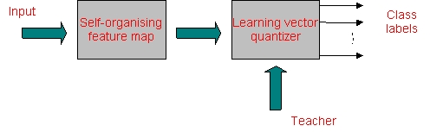
Learning vector quantization
The SOM algorithm provides an approximate method for computing the Voronoi vectors in an unsupervised manner, with the approximation being specified by the weight vectors of the neurons in the feature map.
Computation of the feature map can be viewed as the first of two stages for adaptively solving a pattern classification problem as shown below. The second stage is provided by the learning vector quantization, which provides a method for fine tuning of a feature map.

Slide 21
Learning vector quantization
Learning vector quantization (LVQ) is a supervised learning technique that uses class information to move the Voronoi vectors slightly, so as to improve the quality of the classifier decision regions.
An input vector x is picked at random from the input space. If the class labels of the input vector and a Voronoi vector w agree, the Voronoi vector is moved in the direction of the input vector x. If, on the other hand, the class labels of the input vector and the Voronoi vector disagree, the Voronoi vector w is moved away from the input vector x.
Let us denote {w_{j}}_{j=1}^{l} the set of Voronoi vectors, and let {x_{i}}_{i=1}^{N} be the set of input vectors. We assume that
N >> l.

Slide 22
Learning vector quantization
The LVQ algorithm proceeds as follows:
  Suppose that the Voronoi vector w_{c} is the closest to the input vector x_{i}. Let C_{wc} and C_{xi} denote the class labels associated with w_{c} and x_{i} respectively. Then the Voronoi vector w_{c} is adjusted as follows:
    If C_{wc} = C_{xi} then
    W_{c}(n+1)= w_{c}(n)+a_{n}[x_{i}- w_{c}(n)]
    Where 0< a_{n} <1
    If C_{wc} ≠ C_{xi} then
    W_{c}(n+1)= w_{c}(n)-a_{n}[x_{i}- w_{c}(n)]
  The other Voronoi vectors are not modified.
It is desirable for the learning constant a_{n} to decrease monotonically with time n. For example a_{n} could be initially 0.1 and decrease linearly with n.
After several passes through the input data the Voronoi vectors typically converge at which point the training is complete.

Slide 23
https://www.youtube.com/watch?v=9ZhwKv_bUx8
https://www.youtube.com/watch?v=abF_FdCb5OI&t=41s
https://www.youtube.com/watch?v=mbS7reecXZg

Slide 24

12/12/14
CSE510, Lovely Professional University, Phagwara

